Slide 1
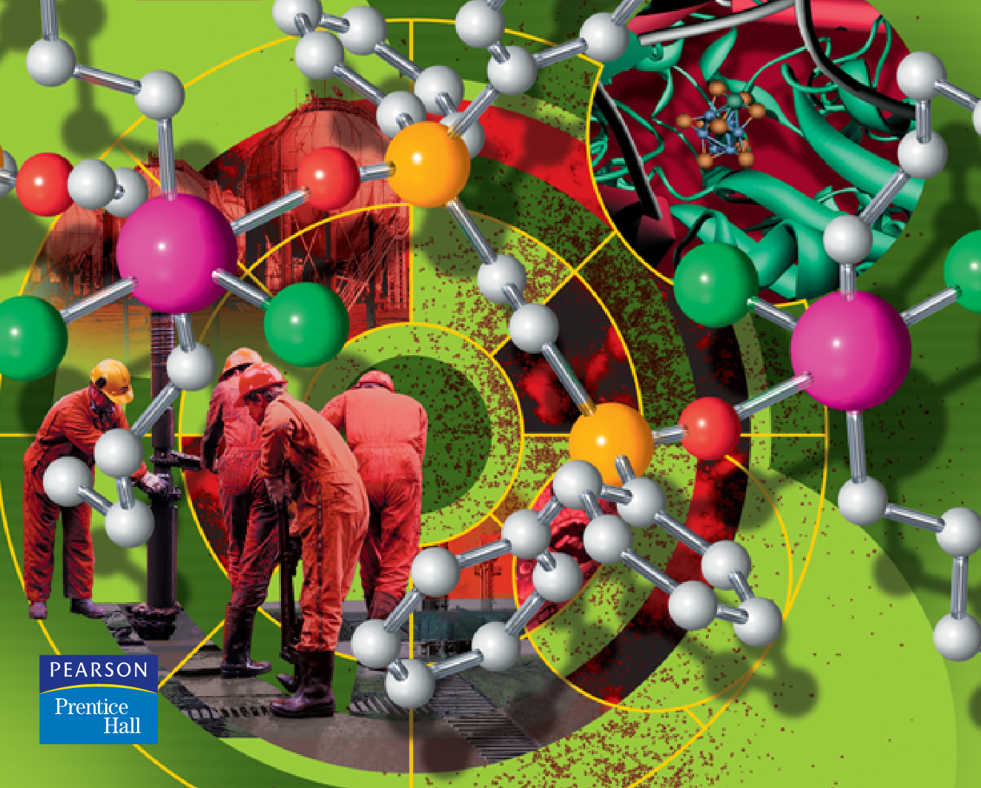
Chemistry of d-block Elements

Slide 2
Periodic Table
s-block
p-block
d-block transition elements
f-block transition elements

Slide 3
The d-Block Elements
Definition
What are transition elements and d-block elements?
Can we use the term transition elements with d-block elements interchangeably?
Transition elements-
an element that have partly filled d or f subshells in their atomic state or
elements that have partly filled d or f subshells in any of their commonly occurring oxidation states when in combined state
d-block elements
Elements in which the d-orbitals are progressively filled
E.g. Cr is a transition and d-block element
Zn, Cd & Hg are d-block elements but are not transition elements

Slide 4
The d-Block Elements
The d-block elements are located in the middle of the periodic table (between s and p-block elements) and consist of metals only
It consists of four series; each series consists of 10 elements
These are:
3d series or First transition series : Scandium (Sc, Z = 21) to Zinc (Zn, Z=30)
4d series or Second transition series: Yttrium (Y, Z =39) to Cadmium (Cd, Z = 48)
5d series or Third transition series: Lanthanum (La, Z=57) to Hafnium (Hf, Z=72) through Mercury (Hg, Z = 80)
6d series or Fourth transition series: Actinium (Ac, Z=89) to Rutherfordium (Rf, Z=104) through Ununbium (Uub, Z=112) or incomplete series
In these elements, the last electron enters the d orbital of the penultimate shell i.e. the last electron fills (n-1)d orbital.
d-block fig.pptx

Slide 5
General physical Properties of d-block Elements
Physical properties depend on outer electrons and the electron arrangement
The similarities in general physical properties of s-block and p-block elements in the periodic table are encountered down a group rather than across a period.
However, in case of d-block elements they show a remarkable similarity across the transition metal series.
In general, the d-block metals are
denser, harder, and have higher melting points and boiling points than the main group metals
Some of the physical properties of these elements are discussed as follows.

Slide 6
Density
The transition elements are much denser than the s-block elements and show a gradual increase in density from left to right across a period.
Also densities increase upon descending down the group.
The volumes of the transition metals are low when compared with main group elements because of the nuclear charge increase and hence the outer electrons are strongly attracted by the nucleus.
Moreover, the extra electrons added occupy the inner orbitals.
For this reason the densities of transition metals are high. Osmium (22.57g.cm⁻³) and iridium (22.61g.cm⁻³) are the elements with the highest densities.

Slide 7
Melting and Boiling Points
In a given transition series, the melting and boiling points 1st increases up to the middle and then decreases.
This can be explained in terms of metallic bond strength which depends on the number of unpaired electrons
As the number of unpaired electron increases, the metallic bond strength increases and hence the melting point also increases
Another factor which affects the m.p is heat of atomization and stable electronic configuration (half filled or fulfilled d-orbitals inherently).
Mn and Tc have low melting point even though they have d⁵ configuration. This is because of their low heat of atomization.
In case of Mn, the 3d electrons are more tightly held by Mn atomic nucleus and this reduces delocalization of electrons resulting in weaker metallic bonding.
The m.ps of second and third row transition series is higher than that of the first row due to their higher enthalpies of atomization.

Slide 8
Hardness
The transition metals (with the exception of Zn, Cd and Hg) are very much hard and have low volatility.
This property is attributed to the greater number of valency electrons per atom available for bonding in the metal, and this number clearly depends on the number of d-electrons.
Conductivity
Transition metals have high electrical and thermal conductivity.
The high electrical conductivity of these metals is due to the presence of mobile valence electrons. They move readily in an electric field and thus conduct electricity throughout the metal from one end to the other.
The high thermal conductivity of these metals is again due to presence of these mobile electrons.
If one part of the metal is heated, the electrons in that part acquire a large amount of kinetic energy which makes them to move rapidly through the crystal and pass on heat to other parts of the metal.

Slide 9
Ductility and Malleability
Transition elements are maleable (form sheets) and ductile (from wires).
In metallic bond, the bond holding the positive ions (M^{n+}) and the valence electrons is non directional.
In other words, the force of attraction between the M^{n+} ions and valence electrons is uniform in all directions. And also the bonds holding the crystall latice in metals is not rigid.
The result is that M^{n+} ions can be easily moved from one lattice site to another. The nearest neighbouhrs can thus be changed easily and new metal bonds can be formed readily.
This explains why metals are malleable i.e. they can be flattened out into thin sheets when hammered.
The ease with which the metal ions can be moved from one lattice to another is also resposible for the fact that the metals are ductile i.e they can be drawn into wire by very little expenditure of energy.

Slide 10
Luster
Transition metals are lustrous (shinning properties).
This can be explained as due to presence of the highly mobile electrons.
As a beam of light comprising of electromagnetic waves falls on the surface of a metal, the electric field associated with light waves sets the electrons present on the surface of the metal into and from oscillations.
A moving charge always emits electromagnetic energy. Hence, oscillating electrons emit electromagnetic energy in the form of light. Thus, when light falls on a metal surface, it appears as if light is being reflected.
Tensile Strength
Metals have high tensile strength that is they can resist stretching without breaking.
This is due to the existence of strong electrostatic attraction between the positively charged metals ions and the ‘sea’ of negative electrons surrounding them.

Slide 11
Periodic Trends in the d-block Elements
Periodic trends are the tendencies of certain elemental characteristics to increase or decrease as one progress along a row or a column of the periodic table of the elements.
Regular changes in electronegativity, atomic size, ionization energy, and other variables across the periodic table allow us to make systematic predictions about the behavior of similar compounds.
The properties of the transition elements do not vary greatly across a period. For example, consider the third period elements.
Sodium and magnesium have distinctive metallic properties, silicon is a metalloid, phosphorous and sulfur are solids with nonmetallic properties, and both chlorine and argon are gases.
There is a distinct progression from elements with metallic properties to elements with nonmetallic properties.
In contrast, the properties of the transition metals do not vary greatly moving across a period.
All of the transition elements have definite metallic properties. The following are the periodic trends of these elements.

Slide 12
Atomic and Cationic Electron Configurations
The building up of electronic configurations of elements follow:
➔Aufbau principle: sub-shells with lowest energy must be filled first.
➔Hund’s rule: each degenerate orbital must first receive one electron before receiving a second electron
➔Pauli exclusion principle: electrons in one orbital must have opposite spins
3d and 4s sub-shells are very close to each other in energy.
Electrons enter 4s sub-shell first and Electrons leave 4s sub-shell first.
General electron config. [filled shell](n-1)d^{x}ns²
Transition elements are characterized by
Full outer orbital ( 4s² )
Incompletely filled penultimate d-orbital ( 3d^{n})
A half-filled or fully-filled d sub-shell has extra stability

Slide 13
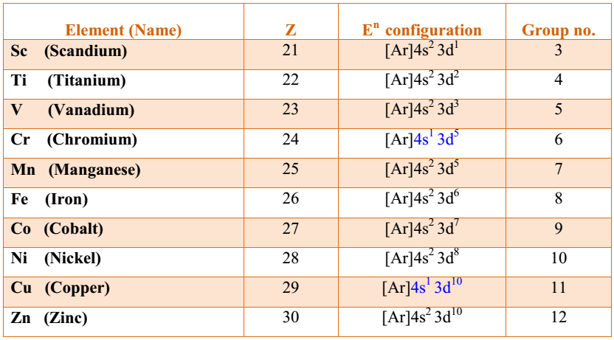
Electronic configurations of the first series of the d-block elements
During writing the electronic configuration of cations, the 4s-electrons are removed before the removal of the 3d-electrons. The reason for this is that in a metal cation the energy of 3d-orbitals is lower than the energy of 4s-orbitals (when filling electrons, the energy of the 4s orbital is lower than 3d-orbitals). For example, V⁺, V²⁺, V³⁺and V⁴⁺can be formed, by removing 1, 2, 3 and 4 electron(s) respectively from V⁰.

Slide 14
Electronic Configurations
Examples:
➔The electronic configuration of titanium:
1s²2s²2p⁶3s²3p⁶4s²3d²
➔ The electronic configuration of zinc:
1s²2s²2p⁶3s²3p⁶4s²3d¹⁰
To get extra stability, electrons are exchanged between these orbitals and give rise to anomalous configurations
E.g.,
1) Cr 4s¹3d⁵
2) Mo 5s¹4d⁵
3) W 6s¹5d⁵
4) Cu 4s¹3d¹⁰
5) Ag 5s¹4d¹⁰
These elements show anomalous electronic configurations as the atoms with half filled or full filled d-orbitals are more stable due to greater exchange energy

Slide 15
Electronic Configurations of Transition Metal Ions
Electronic configuration of Fe²⁺
Fe – 2e⁻ → Fe²⁺
Fe – 2e⁻ → Fe²⁺
[Ar] 4s²3d⁶
valence ns e⁻’s removed first
Fe – 2e⁻ → Fe²⁺
[Ar] 4s²3d⁶ [Ar]3d⁶

Slide 16
Electronic Configurations of Transition Metal Ions
Electronic configuration of Fe³⁺
Fe – 3e⁻ → Fe³⁺
Fe – 3e⁻ → Fe³
[Ar]4s²3d⁶
valence ns e⁻’s removed first, then n-1 d e⁻’s
Fe – 3e⁻ → Fe³⁺
[Ar]4s²3d⁶ [Ar]3d⁵

Slide 17
Electronic Configurations of Transition Metal Ions
Electronic configuration of Co³⁺
Co – 3e⁻ → Co³⁺
Co – 3e⁻ → Co³⁺
[Ar]4s²3d⁷
valence ns e⁻’s removed first, then n-1 d e⁻’s
Co – 3e⁻ → Co³⁺
[Ar]4s²3d⁷ [Ar]3d⁶

Slide 18
Electronic Configurations of Transition Metal Ions
Electronic configuration of Mn⁴⁺
Mn – 4e⁻ → Mn⁴⁺
Mn – 4e⁻ → Mn⁴⁺
[Ar]4s²3d⁵
valence ns e⁻’s removed first, then n-1 d e⁻’s
Mn – 4e⁻ → Mn⁴⁺
[Ar]4s²3d⁵ [Ar]3d³

Slide 19
Atomic Radii and Ionic Radii
In a given transition series, the atomic and ionic radii first decreases, then become constant and increases towards the end of the series.
This is because in transition elements the new electron enters in a d orbital.
Initially since there is a few numbers of d electrons, the shielding effect is very poor.
As the atomic number increases, the nuclear charge also increases, so the atomic radius decreases.
Towards the middle of the series, the increase in nuclear charge is balanced by the shielding effect and so the atomic radius becomes constant.
Towards the end of the series, as the electron- electron repulsion increases the atomic radius also increases.
The atomic and ionic radii of 2nd and 3rd row transition metals are quite similar. This is due to the Lanthanide contraction.
In between the 2nd and 3rd row transition elements, 4f electrons are present.
The 4f electrons have very poor shielding effect and as a result the atomic and ionic radii of Lanthanides decrease from left to right.

Slide 20
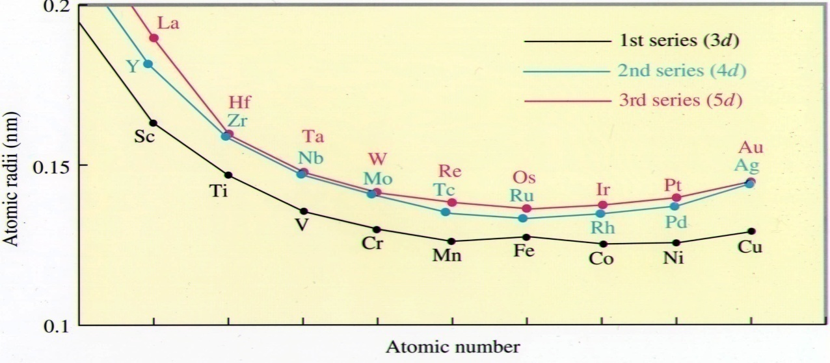
In IIIB group (Sc --> Y --> La), atomic size increase regularly from top to bottom
The atomic radius increases from 3d series to 4d series and remains almost same for 4d and 5d series due to lanthanoid contraction.
Eg. Zr (4d series) and Hf (5d series) have almost equal atomic size (Zr 160pm, Hf 158 pm)

Slide 21
Ionization Enthalpy
The ionization enthalpies of the d-block elements are higher than s-block elements but lower than p-block elements
In the transition series of elements,
the enthalpy of ionization gradually increases across a period even though the increase is not regular
This is due to an increase in the effective nuclear charge experienced by
ns electron, causing a contraction in atomic size and thus making it difficult to ionize
But with increasing number of (n-1)d electrons the effect of increase in nuclear charge is partly balanced by increase in screening effect and consequently the increase is rather small.
The ionization enthalpies of 5d elements are comparatively higher than 4d and 3d elements.
This is because of greater effective nuclear charge felt by outer ns electrons due to imperfect shielding by the intervening 4f electrons.

Slide 22
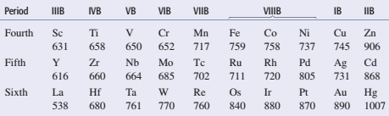
Ionization Enthalpy
The second and third enthalpies of ionization follow the same trend except for
second enthalpy of ionization of chromium and copper
which are relatively high due to additional stability associated with half- filled and completely filled configuration of chromium and copper, respectively
Within a group the ionization enthalpy decreases from 3d to 4d transition series and then increases from 4d to 5d elements.
This increase is because of smaller atomic size of 5d elements due to lanthanide contraction.
First Ionization energies of d-block transition elements

Slide 23
Electronegativity (EN)
EN is a measure of the relative tendency of an atom to attract electrons towards itself when it is chemically combined with another atom
Transition elements have fairly low values of electronegativity.
It increases from Sc to Cu with a fall at Zn.
However, this increase in electronegativity is much slower because the additional electron being added to an inner shell provides relatively good shielding to the outer electrons from the nucleus.
The increasing electronegativity from Sc to Cu means that the elements become slightly less metallic and this is reflected in the increasing positive electrode potentials of their ions M²⁺ and M³⁺.

Slide 24
Electrode Potential
Electrode potential is a measure of the electropositive character and the reactivity of the metals.
The relative stability of metal ion in its various oxidation states and those of different metal ions in the same oxidation state can be found by consideration of standard electrode potential values.
The electrode potential values of first row transition series generally increases from left to right except:
E^{θ}(Cu²⁺/Cu) is positive (+0.34V), while the E^{θ} values of all the other first row transition elements are negative.
This is because the high energy to transform Cu(s) to Cu²⁺(aq) is not balanced by its hydration enthalpy.
So Cu does not easily reacts with acid and liberate H₂. Only oxidizing acids [HNO₃ and hot Conc. H₂SO₄] react with Cu and the acid get reduced.
Along the series, the E^{θ} values become less –ve due to the increase in the sum of 1st and 2nd ionization enthalpies.

Slide 25
Electrode Potential
Stability of the compounds depends on electrode potential which is dependent on
ionization enthalpy,
∆H_{sub} and
∆H_{hyd} energy values
The magnitude of ionization entropy for a particular oxidation state of metal determines
the stability of the compounds in that metal.
Smaller the I.E. of the metal, the stable is its compounds.
Ni →Ni²⁺ + 2e- I.E = 2.49 x 10³kJ/mol
Pt →Pt²⁺ + 2e- I.E = 2.66 x 10³kJ/mol
Ni(II) compounds are thermodynamically more stable than Pt(II) compounds.
Ni →Ni⁴⁺ + 4e- I.E = 11.29 x 10³kJ/mol
Pt →Pt⁴⁺ + 4e- I.E = 9.36 x 10³kJ/mol
Pt(IV) compounds are relatively more stable than Ni(IV) compounds
Notes:
Electrons are lost when a substance is oxidized and electrons are gained
when it is reduced. A reducing agent must therefore supply electrons, and
elements having large negative electrode potentials are strong reducing
agents. When a metal acts as a reducing agent, the half-reaction is
M → M^{n+} +ne-

Slide 26
Cont………
In addition to I.E, ∆H_{sub}, ∆H_{hyd} energy, explain the stability of a particular oxidation state.
1) M(s) →M(g) ∆H_{sub}
2) M(g) →M⁺(g) + e- I. E
3) M⁺(g) + nH₂O →M⁺(aq) ∆H_{hyd} :
∆H (energy charge)= ∆H_{sub} + I. E -∆H_{hyd}
Smaller the value of total energy charge for a particular oxidation state in aqueous solution, greater will be the stability of that oxidation state.
In general, we can say that
more negative the value of the electrode potential for the couple M^{n+}/M, more is the reducing power of the element.
more positive is the value of electrode potential for the couple M^{n+}/M, more is the oxidizing power of the element.

Slide 27
Metallic Character
Metallic character of an element is the easiness of its atom in losing electrons
According to the modern periodic table,
metallic character of an element decreases while moving from left to right across a period
this happens due to number of electrons and protons in an atom increases and these causes an increase in nuclear force on the electrons and hence losing electrons becomes difficult
Metallic character increases down the group due to atomic radius increases and hence it becomes easier to lose electrons
Transition elements show metallic character as they have low ionization energies and have several vacant orbitals in their outermost shell
This property favors the formation of metallic bonds in the transition metals and so they exhibit one or more typical metallic characters at normal temperatures except Zn, Cd and Hg

Slide 28
General chemical properties of d-blocks
The properties of transition metals are largely dependent on the electronic configuration of the electrons in the outer shell and in the penultimate outer shell.
The transition metals have some characteristic chemical properties, including:
Forming compounds with variable oxidation states
A strong tendency to form complexes
Forming colored compounds
Used as catalysts

Slide 29
Variable Oxidation States
One of the notable features of a transition element is the great variety of oxidation states it may show in its compounds
Transition metals show variable oxidation states. This property is due to the following reasons:
1. These elements have several (n–1) d and ns electrons
2. The energies of (n –1)d and ns orbitals are fairly close to each other, which are participant in chemical reactions
In a given transition series, the maximum oxidation state increases up to the middle and then decreases
The variability of oxidation states arises out of incomplete filling of d-orbitals in such a way that their oxidation states differ from each other by unity
In lower oxidation state, the transition element mainly forms ionic compounds

Slide 30
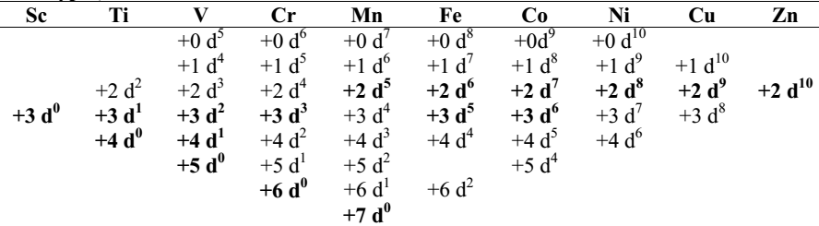
In general,
Higher oxidation states become less stable compared to lower ones as you move from left to right across the series.
Compounds containing metals in high oxidation states tend to be oxidizing agents (e.g. MnO₄⁻).
Compounds containing metals in low oxidation states are usually reducing agents.
The relative stability of the +2 state compared to the +3 state increases across the series (i.e. to the left of the series, the +2 state is highly reducing; whereas to the right of the series, the +2 state is stable, and the +3 state is highly oxidizing).
The relative stability of various oxidation states is correlated with the stability of electronic configurations

Slide 31
Chemical Reactivity
Transition metals vary widely in their chemical reactivity.
Many of them are sufficiently electropositive to dissolve in mineral acids, although a few are ‘noble’ that is, they are unaffected by single acids.
Many of the metals are reactive with mineral acids and librates hydrogen. However, a few of them, such as Ru, Rh, Pd, Os, Ir, Pt, and Au, remains uncreative.
This is due to their high ionization energies and high enthalpies of sublimation.
These elements also react with oxygen to form oxides that adhere to the metal, protecting the metal from further corrosion (Cr, Ni, Co) and form oxides that scale off, resulting in exposure of the metal to further corrosion (Fe).
And some of the metals are noble metals that do not form oxides readily (Au, Ag, Pt, Pd).

Slide 32
Non-Stoichiomtric (Interstitial) Compounds
Another character of transition metals is that they sometimes form nonstoichiometric compounds.
Nonstoichiometric compounds are compounds of indefinite structures and properties.
These are formed when smaller atoms like H, N, C, B etc. are trapped inside voids of the crystal lattice of the metal.
They are usually neither typically ionic nor covalent.
E.g., Fe₃H, Mn₄N, TiC, VH_{0.56}, TiH_{1.7}, ZrH_{1.9}, Fe₃C, Fe_{0.94}O etc…
They are hard and have higher melting & boiling points than those of pure metals.
They retain metallic conductivity and are chemically inert.

Slide 33
Formation of Colored Ions
Most of the transition metal compounds are coloured in their solid or solution form
The colour of transition metal ions is due to
the presence of unpaired electrons in it and
the energy gap between two energy levels in the same d-subshell being small.
The color formation of transition metal ions is mainly depending on:
1. Electronic transition (d-d transition) - an electron jumps from one to another energy level in the same d-sub shell. These is called d-d transition.
The amount of energy required to excite some of the electrons to higher energy states within the same d-sub shell corresponds to energy of certain colors of visible light.
Therefore, when white light falls on the compounds,
some part of its energy corresponding to certain colour is absorbed and
the electron gets raised from lower energy to higher energy & the excess colour is transmitted
The observed colour is complementary of colour absorbed. Eg-Ti⁺³(d¹) is purple.

Slide 34
Formation of Colored Ions
2. Charge Transfer Transitions- an electron may jump from a predominantly ligand orbital to a predominantly metal orbital or vice versa. There are two types of charge transfer transitions. These are:
Ligand-to-metal charge-transfer (LMCT) transition- involves the excitation of an electron from an occupied ligand orbital to an unoccupied metal orbital. These can most easily occur when the metal is in a high oxidation state. For example, the colour of chromate (CrO₄²⁻), dichromate (Cr2O₇²⁻) and permanganate (MnO₄⁻) ions is due to LMCT transitions.
Metal-to-ligand charge transfer (MLCT) - involve the excitation of an electron from an occupied metal orbital to an unoccupied ligand orbital. This requires the presence of π-acceptor ligands such as CO or bipyridyl to provide empty ligand orbitals. Transition will be most likely when the metal is in a low oxidation state and the ligand is easily reduced.
3. The Ligands- The ligands themselves may be colored, and this color may contribute to the color of the complex.

Slide 35
Complex Formation
Transition metals form a large number of complexes.
A complex is formed when a central metal atom or ion is surrounded by other molecules or ions
The cations of d-block elements have strong tendency to form complexes with certain molecules (e.g. CO, NO, NH₃....etc) or ions (e.g. F⁻, Cl⁻, CN⁻....etc) called ligands.
Their tendency to form complexes is due to:
Presence of vacant (n-1)d orbitals which are of appropriate energy to accept lone pair and unshared pair of electrons from the ligands
High charge density of the central metal ions.
Variable oxidation states.
Comparatively smaller size
E.g., [PtCl₄]²⁻, [Cu(NH₃)₄], [Fe(CN)₆]^{4–} etc…

Slide 36
Alloy Formation
Alloys are metallic materials prepared by mixing of two or more molten metals
Alloys may be homogeneous solid solutions in which the atoms of one metal are distributed randomly among the atoms of the other
In homogeneous alloys, atoms of different elements are distributed uniformly.
Such alloys are formed by atoms with metallic radii that are within about 15 percent of each other
Examples include brass (copper-zinc) , bronze (copper-tin), and the coinage alloys.
Heterogeneous alloys, such as tin-lead solder and the mercury amalgam sometimes used to fill teeth, consist of a mixture of crystalline phases with different compositions
The best known are
ferrous alloys: chromium, vanadium, tungsten, molybdenum and manganese are used for the production of a variety of steels and stainless steel

Slide 37
Magnetic Properties
When a magnetic field is applied to substances, mainly two types of magnetic behavior are observed: diamagnetism and paramagnetism
Diamagnetic substances are repelled by the applied field while the paramagnetic substances are attracted
Substances which are attracted very strongly are said to be ferromagnetic which is an extreme form of paramagnetism
Many of the transition metal ions are paramagnetic
Paramagnetism arises from the presence of unpaired electrons, in which each electron has a magnetic moment associated with its spin angular momentum and orbital angular momentum.
For the compounds of the first series of transition metals, the contribution of the orbital angular momentum is effectively quenched and hence is of no significance (negligible).
The magnetic moment is determined by the number of unpaired electrons and is calculated by using the ‘spin-only’ formula, i.e.,

Slide 38
Magnetic Properties
Where, μ_{s} is spin only magnetic moment in units of Bohr magneton (BM), n is the number of unpaired electrons and S is the sum of spin quantum numbers
Example1: Calculate the magnetic moment of a divalent ion in aqueous solution in a high spin state if its atomic number is 25.
Solution: With atomic number 25, the divalent ion in aqueous solution will have d⁵ configuration (five unpaired electrons). The magnetic moment, µ_{s} is
Example2: Calculate the spin only magnetic moment of Ni²⁺ ion in [Ni(H₂O)₆]²⁺ and Fe²⁺ ion in high spin [Fe(H₂O)₆]²⁺.
Solution: The spin only magnetic moment can be:
Ni²⁺ ion in [Ni(H₂O)₆]²⁺ contains d⁸ ion, this gives an octahedral structure, t_{2g}⁶e_{g}², with two unpaired electrons, thus
[Fe(H₂O)₆]²⁺ octahedral high spin Fe²⁺ which is d⁶ with electronic configuration t_{2g}⁴e_{g}², gives four unpaired electrons, so:

Slide 39
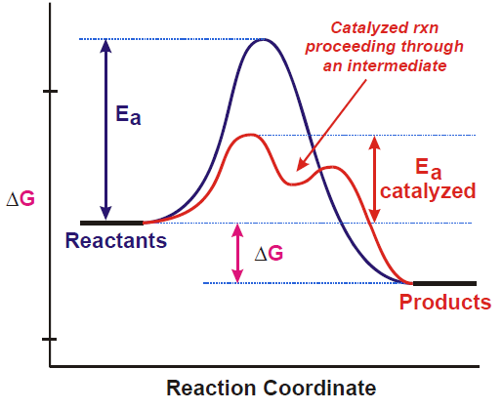
Catalytic Properties
A catalyst is a substance that increases the rate of reaction by lowering the activation energy and providing feasible reaction pathways
A catalyst provides a lower energy pathway for the production of products from reactants, thus allowing the reaction to proceed faster.
A catalyst speeds up the rate of a chemical reaction without itself being consumed during the chemical reaction

Slide 40
Catalytic Properties
Many transition metals and their compounds are important catalysts in many chemical industries due to
their partly filled d-orbitals which act as adsorbent surface with the reactants
Actually, transition elements and their compounds are exerting their catalytic action either homogeneously or heterogeneously.
Homogeneous catalysis: when the catalyst and the reactants as well as the products exist in the same states/phases
Heterogeneous catalysis: the catalysts, the reactants and the products exist in different states/phases
The ability to exhibit catalytic property of transition metals and their compounds is due to
Their tendency to form reaction intermediates with suitable reactants
Their ability to adopt multiple oxidation states
Their ability to form complex compounds

Slide 41
Summary questions
Transition metals are less reactive than alkali and alkaline earth metals. Why?
Elements of transition series show common physical and chemical properties. Explain
4s subshell is filled prior to 3d but on ionization 4s electrons are removed first. Explain
Why the second ionization energy for Cu and Cr are anomalously high.
Discuss the variation in atomic radii of transition metals across a period
Discuss the variation in atomic volume and density of transition metals across a period
Discuss the variation in melting and boiling points of transition metals across a period

Slide 42
8.Why Z, Cd and mercury have low melting points unlike other d block elements?
9. Mercury is a liquid metal. Explain
10. Transition metals are less positive than s block elements. Explain
10. Melting points of d block elements in a series reach a maximum upon the middle, therafter shows a decrease.
11. Discuss the magnetic properties of transition metals.
12. Zn forms only Zn+2 but not Zn+3. why
13. Why are compounds of transition metals colored but that of s block elements
14. Explain the formation of interstitial compounds, non-stoichiometric compounds and alloys.
15. Cu (I) is diamagnetic whereas Cu (II) is paramagnetic expain

Slide 43

Catalysis in synthesis of Organic Compounds
Transition metals and their compounds have become an important instrument in organic synthesis due to their ability to:
activate organic substrates and
promote various interactions between them
The major advantage of organometallic catalysis that has led to its widespread adoption by industry is selectivity, the ability to produce pure products in high yield
The following organic compounds are catalyzed by transition metals and their compounds
1. Acetic Acid Process
Acetic acid was earlier produced via the oxidation of butane in large-scale industrial processes using Co(II) salts as catalysts
The other method of synthesis of acetic acid is from methanol and CO, a process that has been used with great commercial success by Monsanto since 1971. The yields are typically 99% of acetic acid.

Slide 44

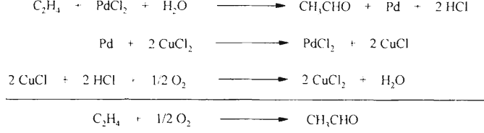
2. Olefin Oxidation
Wacker process for the oxidation of ethylene to acetaldehyde was a great step forward for the production of a variety of organic chemicals
Palladium based catalyst is used for this process and has been found to be extremely useful for the formation of a number of compounds
Wacker process is employed for the production of acetaldehyde from ethylene, acetone and propylene in a homogeneous manner, for other products the catalyst is used in the heterogeneous fashion

Slide 45
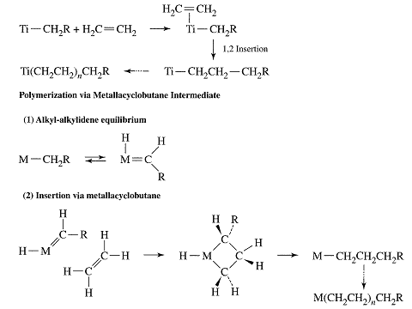
3. Polymerization of Ethylene and Propylene
The polymerization catalysts have been developed as early as 1950s by Ziegler and Natta independently
Ziegler and coworkers reported that solutions of TiCl₄ in hydrocarbon solvents in the presence of Al(C₂H₅)₃ gave heterogeneous solutions capable of polymerizing ethylene.
Subsequently, many other heterogeneous processes were developed for polymerizing alkenes, using aluminum alkyls in combination with transition metal complexes

Slide 46

4. Hydrogenation by Wilkinson's Catalyst
Wilkinson's catalyst, RhCl(PPh₃)₃, participates in a wide variety of catalytic and non catalytic processes.
The bulky phosphine ligands play an important role in making the complex selective-for example, they limit coordination of Rh to unhindered positions on alkenes
In addition to Wilkinson's catalyst, raney nickel, which is very finely divided nickel powder, is a catalyst for the addition of hydrogen across C=C and C≡C bonds
Finely divided platinum, and finely divided palladium also catalyze this sort of reaction, but are a bit expensive. This is a heterogeneous system.
The margarine industry uses the above type of reaction to convert unsaturated vegetable oils into higher metal point saturated fats-i.e. margarine
Raney Ni
2CH₂=CH_{2(g)} + H_{2(g)} ------------>2CH₃-CH_{3(g)}

Slide 47

5. Hydrocarbons and Alcohols from synthesis gas
An equimolar mixture of H₂ and CO (called "synthesis gas" or "syn gas") can be used with metallic heterogeneous catalysts in the synthesis of a variety of useful organic products

Slide 48
Catalysis in synthesis of Inorganic Compounds
Transition metals and their compounds are very important catalysts in the manufacturing of inorganic compounds
Some inorganic compounds that are catalyzed by transition metals and their compounds are:
1. Haber process
This is one of the best known reactions involving a transition metal catalyst.
It is the formation of ammonia from nitrogen and hydrogen using iron as the catalyst. This is a heterogeneous system.
2. Contact Process
This reaction is part of the production of sulphuric acid.
The reaction between sulphur dioxide and oxygen to form sulphur trioxide is catalyzed by vanadium (V) oxide, V₂O₅. This is a heterogeneous system.
Fe
N_{2(g)} + 3H_{2(g)} ------------>2NH_{3(g)}
V₂O₅
2SO_{2(g)} + O_{2(g)} ----------> 2SO_{3(g)}

Slide 49
3. Decomposition of Compounds
Hydrogen peroxide decomposes slowly at room temperature and pressure into water and oxygen. A catalyst is added to increase the reaction rate.
Manganese dioxide is a catalyst used to decompose hydrogen peroxide
Lots of other catalysts can catalyze this reaction too, but MnO₂ is one of the best. This is a heterogeneous system
Cobalt (II) catalyses the decomposition of the chlorate (I) anion, in two steps, as it is easily converted to cobalt (III). This is a heterogeneous system
4. Catalytic Convertors
The pollutants NO and CO are removed from car exhaust fumes by passing the exhaust gases over platinum and rhodium to produce nitrogen and carbon dioxide. This is a heterogeneous system
MnO₂
2H₂O_{2(l)} -----------> 2H₂O_{(l)} +O_{2(g)}
4Co(OH)_{2(s)} + 2ClO⁻_{(aq)} + 2H₂O ---------> 4Co(OH)_{3(s)} + 2Cl⁻_{(aq)}
4Co(OH)_{3(s)} ----------> 4Co(OH)_{2(s)} + 2H₂O + O_{2(g)}
2ClO⁻_{(aq)} -----------> 2Cl⁻_{(aq)} + O₂ _{(g})
Pt / Rh
NO_{(g)} + CO_{(g)} ----------> N_{2(g)} +CO_{2(g)}

Slide 50
5. Steam Reforming
In steam reforming, natural gas (consisting chiefly of methane) is mixed with steam at high temperatures and pressures over a heterogeneous catalyst to generate carbon monoxide and hydrogen:
6. Water Gas Shift Reaction
This reaction is an important heterogeneous reaction to produce hydrogen gas from the reaction of CO and steam.
This reaction is favored thermodynamically: at 400°C, ΔG⁰=-14kJ/mol. Removal of CO₂ by chemical means from the product can yield hydrogen of greater than 99% purity.

Slide 51
Descriptive chemistry of selected First Series Transition Metals: Occurrence and Importance of Compounds of the Metals
A. Titanium (Ti)
Titanium is a silver-grey metal with density of 4.5g/cm³ and m.p. about 1950K
When pure it is soft; presence of small amounts of impurity make it hard and brittle
Heating Ti with the non-metals boron, carbon, nitrogen and oxygen gives solids which approach the compositions TiB₂, TiC, TiN and TiO₂; some of these are interstitial compounds
Titanium is not a rare element; it is the most abundant transition metal (0.6% by mass) after iron
Titanium (IV) oxide is widely dispersed in nature, but the main ores are rutile (impure TiO₂) and ilmenite (FeTiO₃)
Rutile is processed by treatment with chlorine to form volatile TiCl₄, which is separated from the impurities and burned to form TiO₂

Slide 52
cont’d….
Titanium (III) compounds can be produced by reduction of the +4 state
In aqueous solution, Ti³⁺ exists as the purple [Ti(H₂O)₆]³⁺ion, which is slowly oxidized to titanium (IV) by air
Titanium (II) is not stable in aqueous solution but does exist in the solid state in compounds such as TiO and the dihalides of general formula TiX₂
The extraction of titanium is still relatively costly;
first the dioxide, TiO₂, is converted to the tetrachloride, TiCl₄, by heating with carbon in a stream of chlorine; the tetrachloride is a volatile liquid which can be rendered pure by fractional distillation
The next stage is the reduction of the tetrachloride to the metal with magnesium, must be carried out in a molybdenum-coated iron crucible in an atmospheric of argon at about 1100K

Slide 53
Uses
Because of its relatively low density and high strength, titanium is an excellent structural material, especially in jet engines
In addition, the resistance of titanium to chemical attack makes it a useful material for
pipes, pumps, and reaction vessels in the chemical industry
Titanium dioxide (TiO₂), is a highly opaque substance used as white pigment in
paper, paint,
linoleum,
plastics,
synthetic fibers,
whitewall tires and cosmetics

Slide 54
B.Vanadium (V)
Vanadium is widely spread throughout the earth’s crust (0.02% by mass)
Vanadium occurs in several minerals such as:
vanadinite (Pb₅(VO₄)₃Cl), carnotite (K₂(UO₂)₂(VO₄)₂.3H₂O),
roscoelite (a vanadium-containing mica),
polysulfide- patronite (VS₄) and
phosphate rock and some crude oils
The pure metal is very difficult to prepare because it combines even more readily with hydrogen, carbon, nitrogen and oxygen, and it also dissolves readily in oxidizing acids
Pure vanadium can be obtained from the electrolytic reduction of fused salts, such as VCl₂, to produce a metal that is steel gray, hard, and corrosion resistant
The principal oxidation state of vanadium is +5, found in compounds such as the orange V₂O₅ (mp=650ºC) and the colorless VF₅ (mp=19.5ºC)

Slide 55
cont’d….
The higher oxidation states, +5 and +4, do not exist as hydrated ions of the type V^{+n}(aq) because the highly charged ion causes the attached water molecules to be very acidic
The H⁺ ions are lost to give the oxycations : VO₂⁺ and VO²⁺
The hydrated V³⁺and V²⁺ions are easily oxidized and thus can function as reducing agents in aqueous solution
Uses
V is used mostly in alloys with other metals such as iron (80% of vanadium is used in steel) and titanium
For example, ferrovanadium, produced by the reduction of a mixture of V₂O₅ and Fe₂O₃ with aluminum, is added to iron to form vanadium steel, a hard steel used for engine parts and axles
Vanadium (V) oxide is used as a catalyst
in the oxidations of SO₂ to SO₃ in the production of H₂SO₄ and
naphthalene to phthalic acid

Slide 56
C. Chromium (Cr)
Chromium is a silver-white, lustrous, hard, and brittle metal that takes a high polish (mp: 1857°C)
Chromium is extremely resistant to ordinary corrosive agents
The element is found mainly as the ore
chromite or chrome ironstone, FeCr₂O₄ (iron(II) chromium(III) oxide, (Fe²⁺)(Cr³⁺)₂(O⁻²)₄ )
Less common is crocoite, PbCrO₄, lead (II) chromate
The metal dissolves fairly readily in non oxidizing mineral acids,
but not in concentrated sulphuric acid, phosphoric acid, aqua-regia or nitric acid, either in concentrated or dilute
At elevated temperatures, chromium combines directly with halogens, sulfur, silicon, boron, nitrogen and oxygen

Slide 57

Cont’d…
Cr metal is extracted from chromite w/c is fused with Na₂CO₃ in the presence of air to give water-soluble Na₂CrO₄ and insoluble Fe₂O₃
Extraction with water followed by acidification with H₂SO₄ gives a solution from which Na₂Cr₂O₇ can be crystallized
To produce pure Cr, chromite is roasted in air and then soluble chromium (VI) salts are separated from insoluble Fe₂O₃ by subsequent reduction with carbon and aluminium
The common oxidation states of chromium in compounds are +2, +3 and +6
The chromium(II) ion, [Cr(H₂O₎₆]²⁺(aq), has a bright blue color
The ion is obtained when an acid, such as HCl(aq), reacts with chromium metal

Slide 58
Cont’d…
The chromium(II) ion is easily oxidized to chromium(III) ion by air (O₂) which is green
Chromium metal burns in air to give chromium(III) oxide, Cr₂O₃ (dark green solid)
Chromium(III) oxide dissolves in acid solution to form the violet-colored ion [Cr(H₂O)₆]³⁺(aq)
Potassium chromium(III) sulfate (or chrome alum), KCr(SO₄)₂.12H₂O, is a common chromium(III) salt (deep purple )
Chromium(III) chloride is another compound of Cr in +3 oxidation state (reddish violet solid)
Compounds of Cr in +6 oxidation states are:
chromium trioxide (CrO₃) (red)
chromate ion, CrO₄²⁻ (yellow)
dichromate ion, Cr₂O₇²⁻ (Orange)

Slide 59

Cont’d…
CrO₃ precipitates when concentrated sulfuric acid is added to concentrated solutions of a dichromate salt
Na₂CrO₄, is prepared from chromite, FeCr₂O₄(s)
Sodium chromate can be easily converted to sodium dichromate by treating it with an acid
The chromate and dichromate ions are in equilibrium, which is sensitive to pH changes; lower pH favors dichromate ion
Increasing the H⁺ concentration pushes the equilibrium to the right, according to Le Châtelier’s principle
The dichromate ion is a strong oxidizing agent in acid solution
Notes:
Le Châtelier’s principle
When stressed, a system that was at equilibrium returns to its equilibrium state by reacting in a manner that relieves the stress.

Slide 60
Uses
One of the chief uses of chromium is in steel making (ferrochrome)
Cr is used as an electroplated protective coating
Chromium salts are used as dyes, pigments, and preservatives
CrO₃ or chromocene are used as catalysts in alkene polymerization
Chromium trioxide is used in chromium plating
Cr₂O₃ is used as a paint pigment (chrome green)
A mixture of chromium(VI) oxide and concentrated sulfuric acid, commonly called cleaning solution
is a powerful oxidizing medium that can remove organic materials from analytical glassware
Cr(III) is involved in the regulation of glucose levels and is often taken as a dietary supplement

Slide 61
D. Manganese (Mn)
Manganese is grey-white, resembling iron, but is harder and very brittle (mp: 1244°C)
Manganese is the third most abundant transition metal after iron and titanium and is widely distributed in the earth's crust (0.1%)
It is found mainly as a
silicate mineral, braunite ( Mn₇SiO₁₂ (3Mn₂O₃.MnSiO₃)), containing both manganese (II) and manganese (III) and pyrolusite (MnO₂)
Other manganese ores are
psilomelane, manganite (MnO(OH)), hausmannite (Mn₃O₄),
rhodochrosite (MnCO₃) and rhodonite (MnSiO₃)
The metal is reactive which:
slowly reacts even with cold water
dissolves readily in dilute acids to give manganese(II)salts
is not easily attacked by air

Slide 62
Cont’d…
Mn metal can be extracted by
Reduction of pyrolusite, manganese(IV)oxide by heating with aluminium gives an explosive reaction, and
the oxide Mn₃O₄ must be used to obtain the metal and is purified by distillation in vacuo just above its melting point (1517K)
electrolysis of aqueous manganese(II) sulphate (pure metal)
Manganese can exist in all oxidation states from +2 to +7, although +2 and +7 are the most common
Manganese(II) forms an extensive series of salts with all the common anions such as
nitrate, chloride, and sulfate
In aqueous solution Mn²⁺ forms [Mn(H₂O)₆]²⁺, which has a light pink color
When base is added to a solution containing manganese(II) ion, the white manganese(II) hydroxide is formed

Slide 63
Cont’d…
Manganese(III) state is favored under basic conditions, and the manganese(II) hydroxide oxidizes in air to a brown hydrated manganese(III) oxide, MnO(OH)
Manganese(VII) is found in the intensely purple permanganate ion, MnO₄⁻ (strong oxidizing agent)
Potassium manganate(VII) can be prepared by:
Electrolytic oxidation of manganese metal (oxidation from 0 to +7) using a manganese anode in potassium carbonate solution,
Oxidation of manganate(II) (oxidation +2 to +7), using the peroxodisulphate ion S₂O₈²⁻ and a manganese(II) salt, and
Oxidation of manganese(IV) by fusion of MnO₂ with potassium hydroxide

Slide 64


Cont’d…
Potassium manganate(VII) disproportionate on heating
The green manganate (VI)ion which is only stable in alkaline solution disproportionate in neutral or acidic solutions
Uses
The main use of the element is in the steel industry
Steels that contain Mn are:
suitable for crushing, grinding and excavating machinery
Manganese is also used in aluminium alloys, such as those used in drinks cans, at a level of ∼1 percent to improve corrosion resistance
MnO₂ is a major component of alkaline batteries
Mn salts are used as pigments in ceramics and glasses
Manganese is important in biology and is present as the active-site metal in numerous enzymes across all forms of life
MnO₄⁻ is strong oxidizing agent which is widely used as analytical reagent in acidic solution

Slide 65
E. Iron (Fe)
After aluminium, iron is the fourth most abundant metal of all the elements
The Earth’s core is believed to consist mainly of iron
It occurs chiefly as oxides
haematite (Fe₂O₃), magnetite (lodestone) (Fe₃O₄)
The other common sources of iron are
siderite (FeCO₃), goethite (α-Fe(O)OH) and lepidocrocite (β-Fe(O)OH,
iron pyrites (FeS₂) and chalcopyrite (CuFeS₂)
It is the most important metal in everyday life because of
its abundance and cheapness
its ability to be cast, drawn and
forged for a variety of uses
The process of extraction requires first smelting (to obtain the crude metal) and then refining
In smelting, iron ore (usually an oxide) is mixed with coke and limestone and heated and hot air (often enriched with oxygen) is blown in from beneath (in a blast furnace)

Slide 66

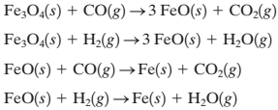
Cont’d…
At the lower, hotter part of the furnace, CO is produced (essential reducing agent)
Pure iron is prepared by reduction of iron(II)oxide with hydrogen, or by electrolysis of an iron(II)-containing aqueous solution
The chemistry of iron mainly involves its +2 and +3 oxidation states
Iron combines with
most non-metals on heating, and forms the oxides Fe₂O₃ and (mainly) Fe₃O₄ when heated in air above 430K
Iron dissolves in most dilute acids, giving iron(II)solutions

Slide 67

Cont’d…
In aqueous solutions iron(II) salts are generally light green because of the presence of [Fe(H₂O)₆]²⁺
Aqueous solutions of iron(III) salts are usually yellow to brown in color due to the presence of [Fe(OH)(H₂O)₅]²⁺, which results from the acidity of [Fe(H₂O)₆]³⁺
A specific test for the presence of the iron(II) ion is
the addition of a solution of hexacyanoferrate(III) ion, [Fe(CN)₆]^{3–}, to give a dark blue precipitate of iron(II) hexacyanoferrate(III), Fe₃[Fe(CN)₆]₂
3Fe²⁺ (aq) + 2[Fe(CN)₆]³⁻ (aq)→ Fe₃[Fe(CN)₆]₂ (s) (Turnbull’s Blue Test)
A specific test for the presence of the iron(III) ion is
the addition of a solution of hexacyanoferrate(II) ion, [Fe(CN)₆]^{4–}, to give a dark blue precipitate of iron(III) hexacyanoferrate(II), Fe₄[Fe(CN)₆]₃
4Fe³⁺ (aq) + 3[Fe(CN)₆]⁴⁻ (aq) → Fe₄[Fe(CN)₆]₃ (s) (Prussian blue Test)

Slide 68
Uses
Iron is the most used of all the metals, including 95% of all the metal tonnage produced worldwide
Its applications go from
food containers to family cars,
screwdrivers to washing machines,
cargo ships to paper staples
Steel is the best known alloy of iron, and some of the forms that iron takes include:
pig iron, cast iron, carbon steel, wrought iron,
alloy steels and iron oxides
The compound Prussian blue, its crystal lattice contains alternating iron(III) and iron(II) ions is used
in blue inks and paints,
as blue pigment in traditional architectural and engineering blueprints

Slide 69
F. Cobalt (Co)
Cobalt is a bluish white, hard metal, and like iron, cobalt is a magnetic (ferromagnetic) material
The principal ores of Cobalt are
cobaltite [(Co,Fe)AsS], erythrite [Co₃(AsO₄)₂.8(H₂O)],
glaucodot [(Co,Fe)AsS] and skutterudite [CoAs₃]
It also occurs biologically in vitamin B12 (a complex of cobalt(III))
Extraction is carried out by a process essentially similar to that used for iron,
but is complicated because of the need to remove arsenic and other metals
The most common oxidation numbers of cobalt are +2 and +3
Chemically it is somewhat similar to iron;
when heated in air it gives the oxides Co₃O₄ and CoO
it is less readily attacked by dilute acids
The simple salts in Co³⁺ oxidation state are powerful oxidizing agents and oxidize water

Slide 70

Cont’d…
Cobalt(III) forms a wide variety of coordination compounds (octahedral)
The low-spin complexes are very kinetically inert (separate different optical isomers where they are feasible)
Typical examples of cobalt(III) complexes are
hexaamminecobalt(III) ion, [Co(NH₃)₆]³⁺;
hexacyanocobaltate(III) ion, [Co(CN)6]³⁻;
hexanitrocobaltate(III) ion, [Co(NO₂)₆]³⁻ and
tris(1,2-diaminoethane)cobalt(III) ion, [Co(en)₃]³⁺
Cobalt in +2 oxidation state also forms different types of salts.
In solution, cobalt(II) salts are pink
due to the presence of the hexaaquacobalt(II) ion, [Co(OH₂)₆]²⁺
When a solution of a cobalt(II) salt is treated with conc. HCl
the color changes to deep blue due to formation of the tetrahedral tetrachlorocobaltate(II) ion, [CoCl₄]²⁻

Slide 71

Cont’d…
The cobalt(II) hydroxide is slowly oxidized by the dioxygen in the air to a cobalt(III) oxide hydroxide, CoO(OH)
Cobalt(II) hydroxide is amphoteric
Uses
Cobalt's most important application is in the production of super alloys
It is also used in airplane parts such as
jet engine components, gas turbines and
magnetic alloys
Cobalt compounds such as cobalt oxide, cobalt potassium nitrite, cobalt aluminate, and cobalt ammonium phosphate are used to make
colored glass, glazes, paints, rubber, inks, cosmetics and pottery

Slide 72
G. Copper (Cu)
Copper is a reddish metal with a face-centered cubic crystalline structure.
It reflects red and orange light and absorbs other frequencies in the visible spectrum due to its band structure
It is malleable, ductile, and an extremely good conductor of both heat and electricity
It is softer than zinc and can be polished to a bright finish
The most important ore is
chalcopyrite or copperpyrites, CuFeS₂
Other natural forms include
basic Carbonates; CuCO₃.Cu(OH)₂ (malachite) and 2CuCO₃.Cu(OH)₂ (azurite)
The process of extraction consists essentially of
(a) separation of the ore from rock, by flotation (selective wetting)
(b) conversion of the sulphide ore to the crude metal, by blowing air through the molten ore

Slide 73
Cont’d…
(c) purification of the crude metal usually by electrolysis;
the crude copper is the anode in an electrolyte of acidified aqueous copper(II) sulphate, and
the pure metal deposits on starting sheets of copper as cathode
Copper has low chemical reactivity
Copper has two common oxidation states: Cu⁺ and Cu²⁺
In moist air it slowly forms a greenish surface film called patina; this coating protects the metal from further attack
Copper is not attacked by water or by dilute non-oxidizing acids to give hydrogen
It is attacked by nitric acid to give a solution of copper(II)nitrate Cu(NO₃)₂
In concentrated sulphuricacid, some copper(II) sulphate is formed in solution

Slide 74
Cont’d…
The +2 state dominates the aqueous chemistry of copper
In aqueous solution, almost all copper(II) salts are blue except copper(II) chloride (green) [planar tetrachlorocuprate(II) ion]
The color is due to the presence of the hexaaquacopper(II) ion, [Cu(OH₂)₆]²⁺
When [CuCl₄]²⁻ is diluted, the color of the solution changes to blue
The color transformations are due to the successive replacement of chloride ions by water molecules
If a solution of ammonia is added to a copper(II) ion solution

Slide 75

Cont’d…
Addition of hydroxide ion to a copper(II) ion solution causes the precipitation of the Cu(OH)₂, a blue-green gelatinous solid
However, warming the suspension causes the hydroxide to decompose to the black copper(II) oxide and water
For most ligands, Cu²⁺ is more thermodynamically stable, but reducing ligands, like iodide, will reduce copper(II) ions to the copper(I) state

Slide 76
Uses
Most copper is used for electrical equipment (60%);
construction, such as roofing and plumbing (20%);
industrial machinery, such as heat exchangers (15%) and
Alloys (5%) such as
bronze (copper-tin),
brass (a copper-zinc alloy),
copper & nickel(cupronickel) [low-denomination coins]
copper-tin-zinc to make guns and cannons (gun metal)
Copper is ideal for electrical wiring

Slide 77

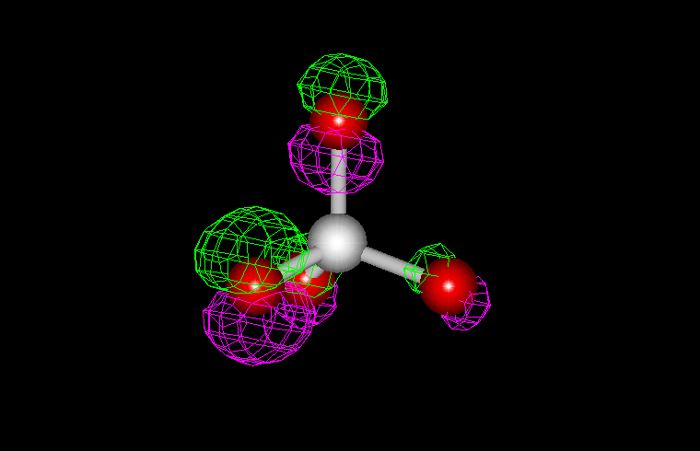
END
Our life depends in our attitude: it will be bright like sun rise if we think positively and
it will be darkened like sunset if we think negatively.

